Slide 1
Hotel Management System
Name – Manpreet Kaur
UID – 24MCA20186
Branch – MCA( UIC )
Section – 24MCA-7A
Submitted To – Tanya Ma’am

Slide 2
Table of Contents
1. Introduction
2. Objectives
3. Technologies Used
4. System Architecture
5. Screenshots (UI)
6. Conclusion

Slide 3
Introduction
The Hotel Management System (HMS) is a web-based application designed to manage hotel operations like room reservations, check-ins/outs, guest records, and real-time room status monitoring efficiently.

Slide 4
Objectives
- Automate daily hotel operations
- Minimize manual errors and delays
- Centralized system for room and guest management
- Improve customer service and data accuracy

Slide 5
Technologies Used
- Frontend: HTML, CSS, JSP, Bootstrap
- Backend: Java Servlets, RESTful APIs
- Database: MySQL
- Server: Apache Tomcat
- Tools: NetBeans, XAMPP

Slide 6
System Architecture
Client → JSP Interface
↓
Servlet Controllers (Java)
↓
MySQL Database
↓
Responses sent as JSON to frontend

Slide 7
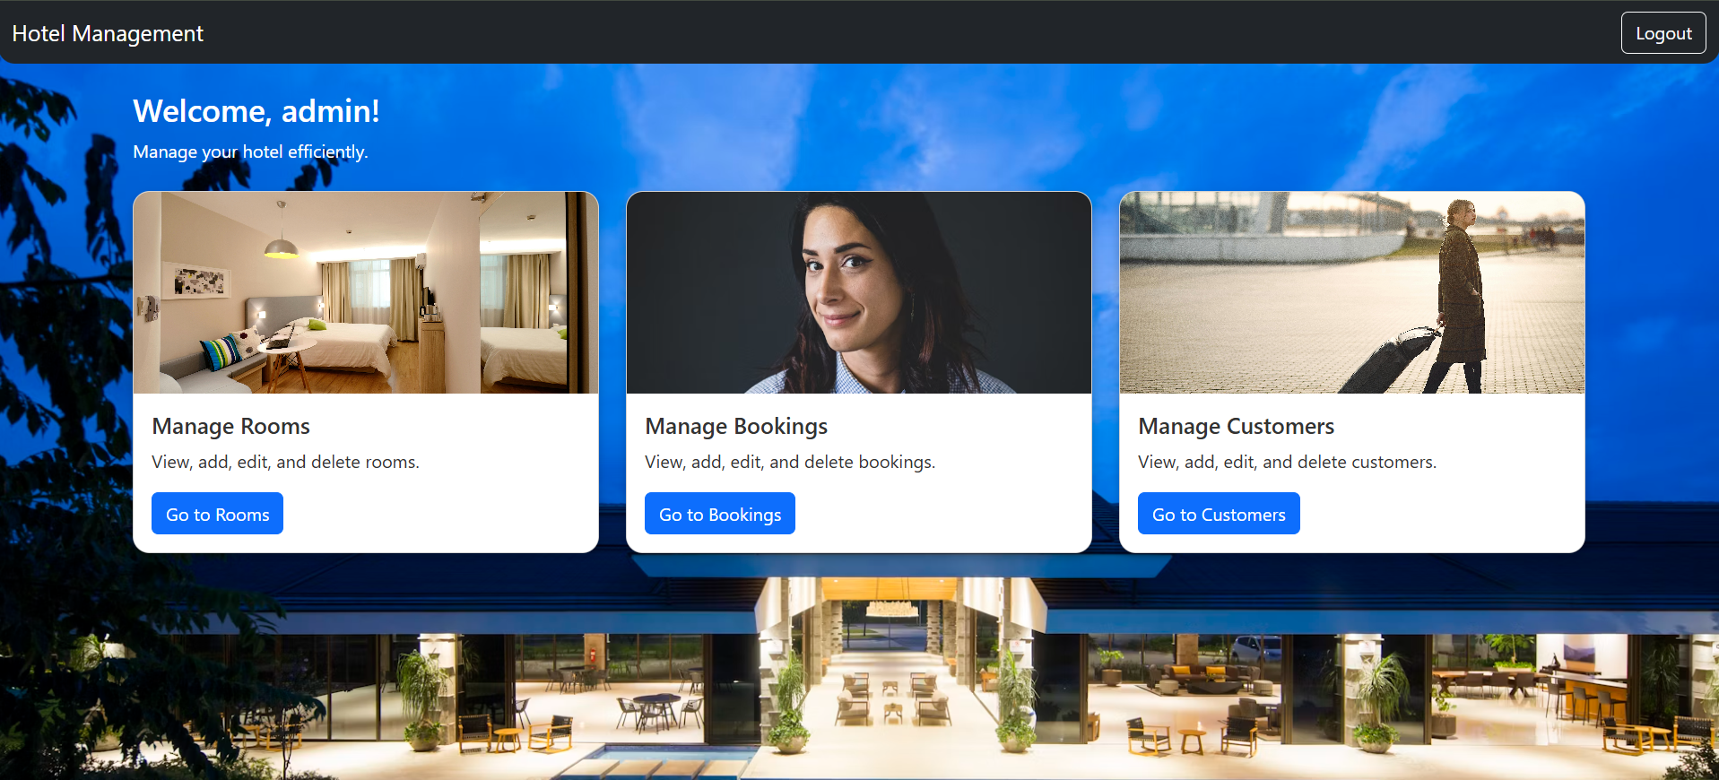

Slide 8
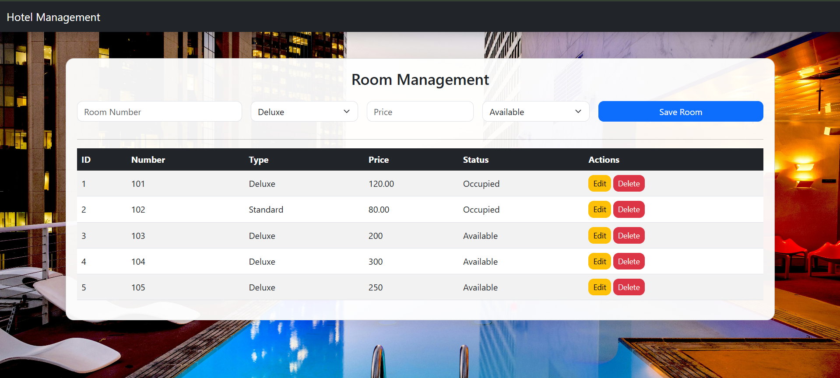

Slide 9
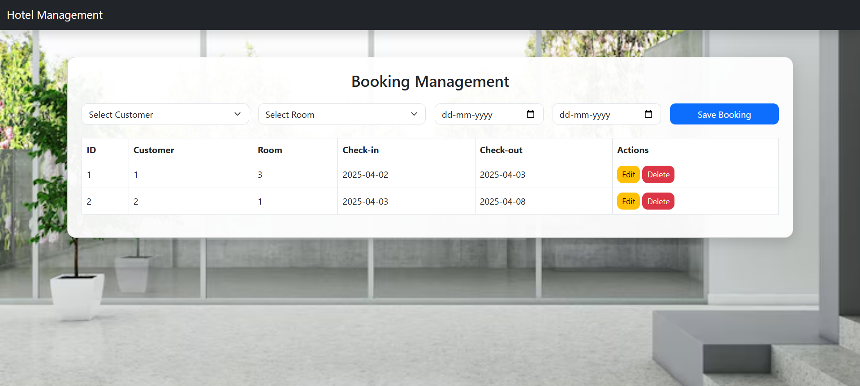

Slide 10
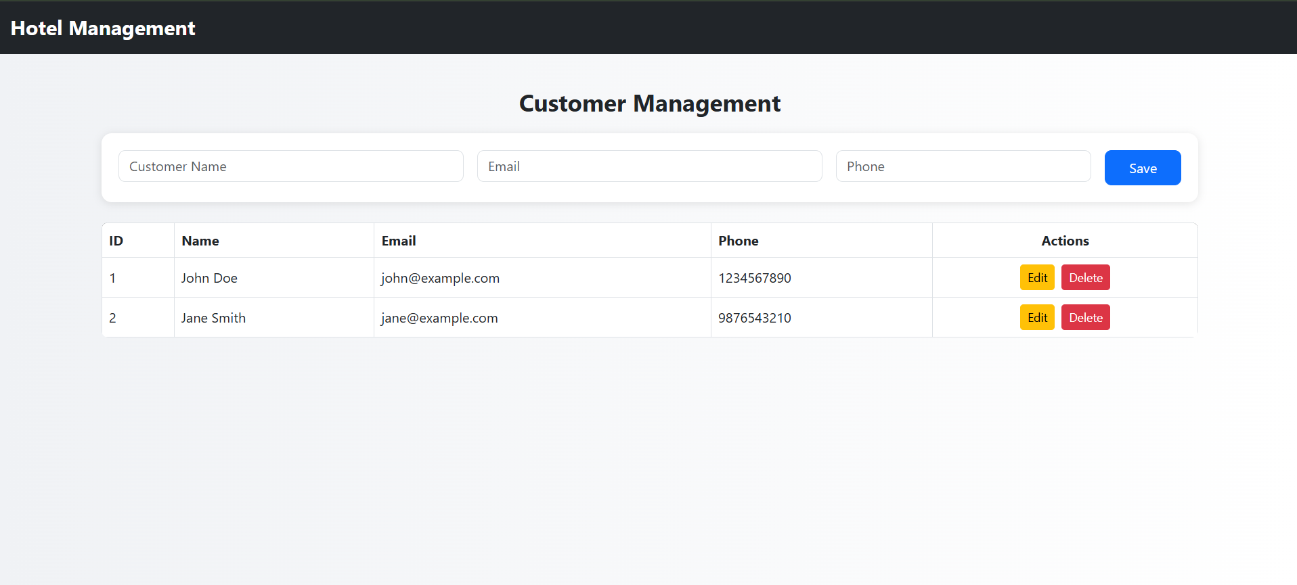

Slide 11
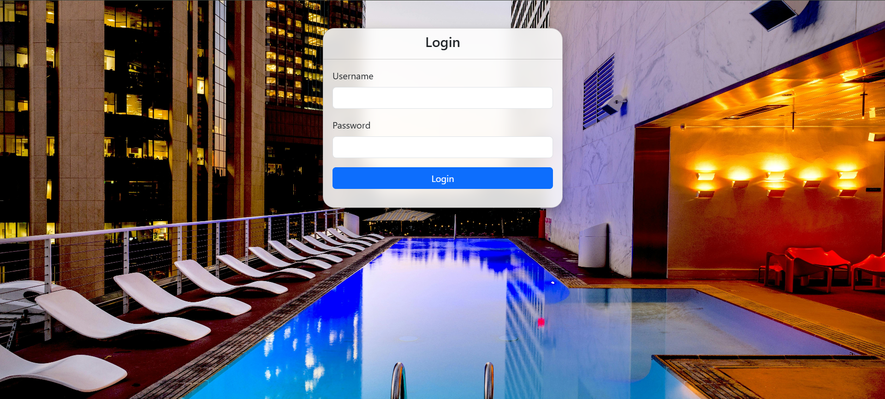

Slide 12
Conclusion
The Hotel Management System improves operational efficiency, reduces human errors, and enhances guest satisfaction. It provides a scalable and robust solution for modern hotel businesses.
Future enhancements could include payment integration and analytics.

